Slide 1
CONDITIONAL STATEMENTS AND LOOPS

Slide 2

The Gap by Ira Glass

Slide 3
Quantity vs. Quality?
In creative endeavors, quantity beats (and creates) quality
The pottery anecdote
Notes:
Why quantity beats (and creates) quality | Planio

Slide 4
Soft Review
What did we talk about last week?
Notes:
Why quantity beats (and creates) quality | Planio

Slide 5
Soft Review
What is Linux?
Notes:
Why quantity beats (and creates) quality | Planio

Slide 6
Soft Review
What is git?
Notes:
Why quantity beats (and creates) quality | Planio

Slide 7
Soft Review
What is Python?
What do you use Python for?
Data Extraction (getting data from databases, APIs, unformatted websites)
Data Transformation (manipulating data and reformatting)
Data Loading (putting data into databases (SQL/NoSQL))
Data Exploration (Pandas)
Data Modeling/ AI Modeling (SciKitLearn/Pytorch)
Backend Development (Flask and FastAPI)
Notes:
Why quantity beats (and creates) quality | Planio

Slide 8
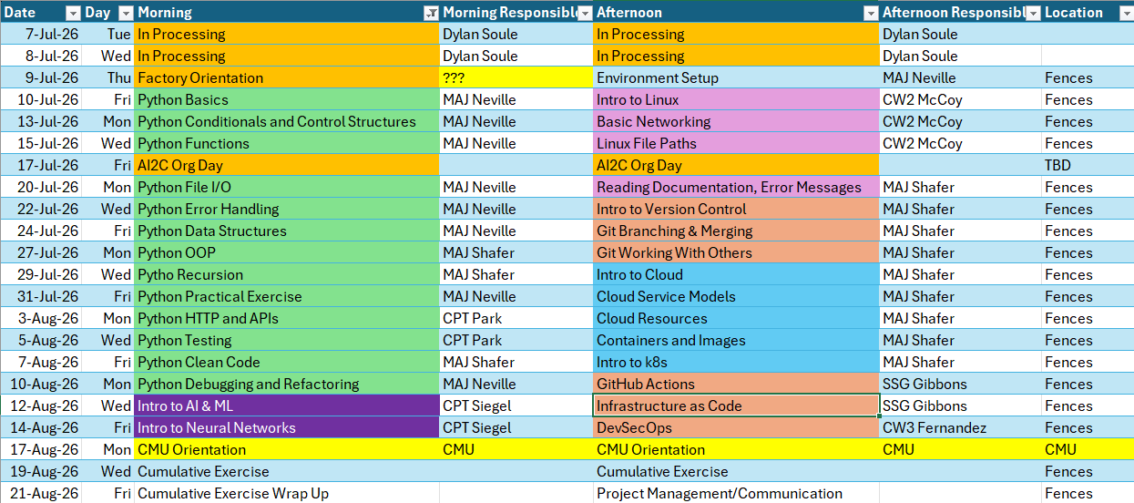
Course Schedule

Slide 9
Review: What are some different datatypes in Python?

Slide 10
Review: How can we get information from a user of our program?

Slide 11
Review: What function allows us to display information in our terminal?
Print()
Print(sep=“x”)
Print(end=“\n\n\n”)

Slide 12
Review: What is type casting, and why is it important?

Slide 13
How do our Python Scripts run…?
Currently, they run from left to right, top to bottom, just like reading a book…
But what if we wanted to only run certain sections of code if a condition was met (if the condition was True!).
How could we do this?
Notes:
From top to bottom…
But what if we wanted to only run certain sections if a condition was met (if the condition was True!)

Slide 14
CONDITIONAL STATEMENTS
Conditions are expressions that evaluate to a Boolean value
They often involve comparison operators (<, >, ==, !=, <=, >=) and logical operators (and, or, not)
Python relies on indentation (whitespace at the beginning of a line) to define code blocks
Incorrect indentation will lead to errors.
You can create Nested Conditional Statements to control the flow of code

Slide 15
IN CLASS EXERCISE
Given:
x = 14
y = 15
Evaluate the following conditional statements
Condition | True/ False
x == 14
x > 14
y <= 15
y > x
not(x < 100)
True
False
True
True
False

Slide 16
IN CLASS EXERCISE
Given:
age = 20
money = 100
isMilitary = True
isOnPermanentProfile = False
Evaluate the following conditional statements
Condition | True/ False
age > 21 and money > 10
age > 18 and money > 0
age > 60 or isMilitary
age > 18 and isMilitary and not(isOnPermanentProfile)
False (You cannot buy an adult beverage!)
True (You can vote!)
True (You can get a discount!)
True (You’re going to war!)

Slide 17
THE "IF" STATEMENT
Executes a block of code only if a given condition evaluates to True
Syntax:
if condition:
# code
Example:
age = 20
if age >= 18:
print(“You are eligible to vote.”)

Slide 18
THE “ELSE” STATEMENT
“Else” is used in conjunction with “if”
Provides an alternate block of code to execute if the “if” condition evaluates to false
Syntax:
if condition:
# code
else:
# code
Example:
temperature = 78
if temperature > 85:
print(“It’s hot out today!”)
else:
print(“It’s not too hot.”)

Slide 19
THE “ELIF” STATEMENT
“elif” is short for else-if
It allows for checking multiple conditions sequentially
If the “if” condition evaluates to false, the “elif” statements are evaluated in order until one evaluates to True
Syntax:
if condition:
# code
elif condition:
# code
else:
# code

Slide 20
THE “ELIF” STATEMENT
Example 1:
score = 89
if score >= 90:
print(“Grade: A”)
elif score >= 80:
print(“Grade: B”)
elif score >= 70:
print(“Grade: C”)
elif score >= 60:
print(“Grade: D”)
else:
print(“Grade: F”)
Example 2 (Is this right? What would this do?):
score = 89
if score >= 90:
print(“Grade: A”)
elif score >= 80 and score < 90:
print(“Grade: B”)
elif score >= 70 and score < 80:
print(“Grade: C”)
elif score >= 60 and score < 70:
print(“Grade: D”)
else:
print(“Grade: F”)

Slide 21
THE “ELIF” STATEMENT
Example 3 (Is this right? What would this do?):
score = 50
if score >= 90:
print(“Grade: A”)
if score >= 80:
print(“Grade: B”)
if score >= 70:
print(“Grade: C”)
if score >= 60:
print(“Grade: D”)
else:
print(“Grade: F”)

Slide 22
NESTED CONDITIONAL STATEMENTS
You can place “if” or “if...else” statements inside other “if” or “else” blocks to create more complex decision structures.
Example:
weather = "rainy“
temperature = 45
if weather == "rainy":
if temperature < 50:
print("It's cold and rainy. Wear a jacket and bring an umbrella.")
else:
print("It's rainy but warm. Just bring an umbrella.")
else:
print("No rain today. Enjoy the weather!")

Slide 23
EXERCISE - CONDITIONAL STATEMENTS
5 minutes
Write a script that asks a user for a number. The script then checks the number and prints “positive,” “zero,” or “negative”
Notes:
Remember:
Defining a function
If-elif-else
Comparison operators
Early exits

Slide 24
Hands-On #1
Take 30 minutes to work through Hands-On #1

Slide 25
Take a 5 minute break
Notes:
Remember:
Defining a function
If-elif-else
Comparison operators
Early exits

Slide 26
How do our Python Scripts run…?
Currently, they run from left to right, top to bottom, just like reading a book…
We also know how to make certain sections of code to run if a condition is met (if it is True!)
What if we want to run certain sections of code over and over again…
For a defined number of iterations (definitive loop --- FOR LOOP)
For an undefined number of iterations, until a condition is met (indefinite loop – WHILE LOOP)
Notes:
From top to bottom…
But what if we wanted to only run certain sections if a condition was met (if the condition was True!)

Slide 27
LOOPS!!!
Notes:
From top to bottom…
But what if we wanted to only run certain sections if a condition was met (if the condition was True!)

Slide 28
But first, a new datatype!
an_example_list = [1, 2, 3, “Hello”, “Goodbye”, 6.0]

Slide 29
The List [ ]
The humble list
Example:
my_list = ['hello’]
my_list.append('goodbye’)
my_list.append(5)
my_list.append(True)
print(my_list)
['hello', 'goodbye', 5, True]
print(len(my_list))
4

Slide 30
List Indexing
my_list = [“Python”, “is”, “oh”, “so”, “fun”]
Index 0 1 2 3 4
-5 -4 -3 -2 -1
my_list[0] = ?
my_list[4] = ?
my_list[-1] = ?
my_list[5] = ?
Python
fun
fun
indexError
Let’s launch the Python interpreter and verify this! Instructor Note: Demonstrate some list methods!

Slide 31
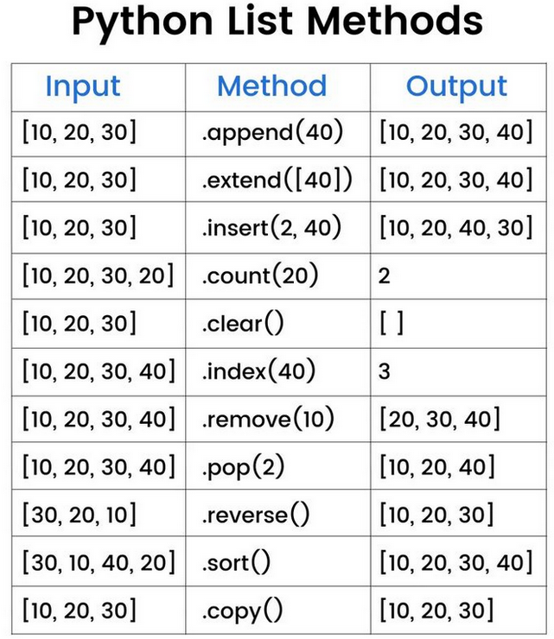
List Methods

Slide 32
RANGE() FUNCTION
A built-in Python function
Output is a “range object,” which is an immutable sequence type and memory efficient compared to a list

Slide 33
RANGE() FUNCTION
range(stop)
Generates a sequence of numbers starting from 0 (default) up to, but not including, the stop value
The numbers increment by 1 (default)
Examples:
range(5) generates 0, 1, 2, 3, 4
range(10) generates ?
range(3) generates ?
0, 1, 2, 3, 4, 5, 6, 7, 8, 9
0, 1, 2

Slide 34
RANGE() FUNCTION
range(start, stop)
Generates a sequence of numbers starting from the start value (inclusive) up to, but not including, the stop value
The numbers increment by 1 (default)
Examples:
range(2, 7) generates 2, 3, 4, 5, 6
range(1, 100) generates
range(10, 21) generates
1, 2, 3, 4 …. 97, 98, 99
10, 11, 12… 18, 19, 20

Slide 35
RANGE() FUNCTION
range(start, stop, step)
Generates a sequence of numbers starting from the start value (inclusive) up to, but not including, the stop value
The numbers increment or decrement by the step value (integer!)
If step is positive, it increments. If step is negative, it decrements (for counting backwards).
step cannot be 0, as it would lead to an infinite loop and raise a ValueError
Example 1: range(1, 10, 2) generates 1, 3, 5, 7, 9
Example 2: range(5, 0, -1) generates 5, 4, 3, 2, 1
Example 3: range(1, 101, 2) generates ?
1, 3, 5, 7, 9.. 99 (all odd numbers up to 101, but not including 99)

Slide 36
LOOPS
Fundamental control flow structures used to execute a block of code repeatedly
Two primary types of loops are “for” and “while” loops, which have distinct purposes
You can nest loops

Slide 37
“FOR” LOOP
For loops iterate over a sequence, such as a list, tuple, string, or range, or other iterable objects
A block of code is executed once for each item in the sequence
Syntax:
for loop_variable in sequence:
# code
Example:
fruits = ["apple", "banana", "cherry"]
for fruit in fruits:
print(fruit)

Slide 38
Instructor Led Examples
Use a for loop to print the numbers from 1 to 10
Create a list. Add an item to the end of the list. Use a for loop to print each item in the list.
Use a for loop to print all the even numbers between 20 and 50
Create the list [10, 20, 30, 40, 50]. Find the average value of the list using a for loop.

Slide 39
“WHILE” LOOP
While loops execute a block of statements repeatedly as long as a given condition is True
The loop continues to execute until the condition becomes false
What if we never update the variable that is being checked by our condition inside the body of our while loop?
Syntax:
while condition:
# block of code
Example:
count = 0
while count < 5:
print(count)
count += 1

Slide 40
Instructor Led Examples
Ask the user to input an even integer number. If the user puts in an odd number, print “This is an odd number”, and then prompt the user for an even number. Continue to do this until the user enters an even number. **Assume the user will always input an integer value**
Hard code a secret integer number between 1 and 100. Ask the user to guess the integer. If they are higher then the secret number, tell them they are higher. If they are lower, tell them they are lower. When they guess it correctly, congratulate them, and end the program.
Bonus: Display how many times the user guessed until they got it correct after they get it correct.

Slide 41
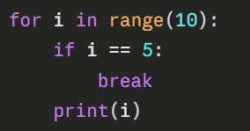
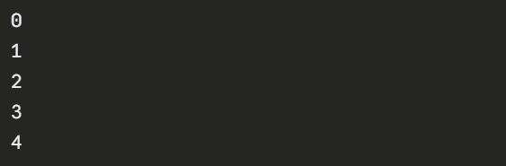
LOOP CONTROL STATEMENTS
break
terminates the entire loop immediately, execution resumes at the statement following the loop’s body

Slide 42
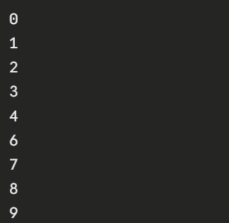
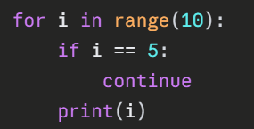
LOOP CONTROL STATEMENTS
continue
skips the rest of the current iteration of the loop and proceeds to the next iteration of the loop

Slide 43
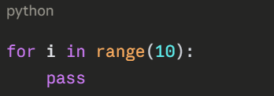
LOOP CONTROL STATEMENTS
pass
null operation, used as a placeholder in loops or other code blocks where a statement is syntactically required but there is nothing to execute

Slide 44
NESTED LOOPS
Python allows loops inside other loops, called nested loops
The inner loop executes completely for each iteration of the outer loop
Example:
for i in range(3):
for j in range(2):
print(i, j)

Slide 45
Hands-On #2
Take 30 minutes to work through Hands-On #2

Slide 46
Questions?

